Slide 1
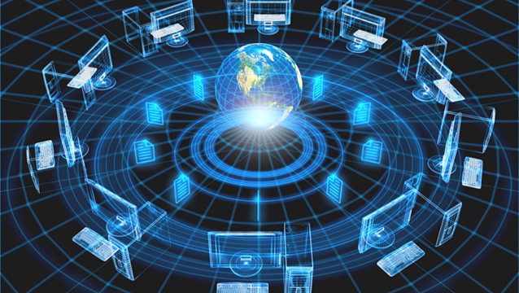
COMPUTER NETWORKING Advantages and Disadvantages
Definition from wiki
Social network is an online community of people with a common interest, using a website or other technologies to communicate with each other and share information and resources.

Slide 2
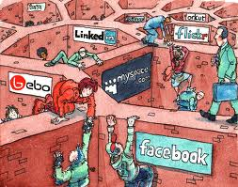
HISTORY OF COMPUTER NETWORKING
This appeared about approximately 20 years ago in 1995.
In early days social network was running on relatively simple software. People use chatting rooms, creating and linking their personal webpages or simply using e-mail addresses. Despite this incredible simplicity it was working well. It was represented by Usenet, Arpanet, Chatnet, Classmates.

Slide 3
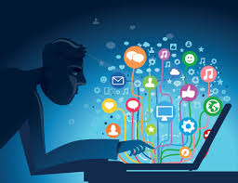
Nowadays the social network is much advanced.
It is supported by much more sophisticated computer platform offering users much more advanced options. It is represented by Facebook, Twitter, LinkedIn. Also there are many others ways to communicate with people on line. People do it via forums, dating sites, making comments to online articles. It’s estimated that half of the world population is involved in the computer network. People use not only old fashion desk top computers and laptops, but mobile phones, which can be regarded as “computers in pockets”

Slide 4
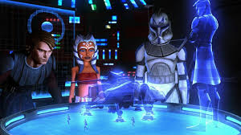
In the future computer networking will be even more sophisticated.
I guess it will be something like merging with the augmented reality, for example, using space glasses like Octopus Rift.
It is when people can simultaneously interact with the virtual reality and the real world.

Slide 5
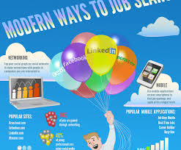
Computer networking became a very important part of people’s lives.
They use it for various purposes:
making friends, finding romance, seeking a new job, for business, receiving support from like-minded individuals, in scientific community.

Slide 6
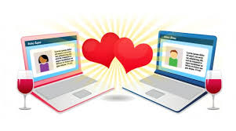
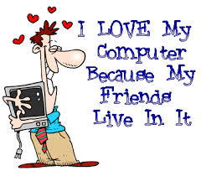

Making friends and finding romance.

Slide 7
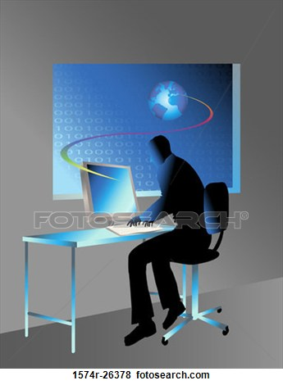
The social network has a lot of advantages
Worldwide Connectivity.
If even people are situated in different cities or even countries being thousands kilometres apart from each other, the distance doesn’t matter any longer.
They are able send messages to each other at the speed of light. It gives them unbelievable advantage which people have never had before.

Slide 8
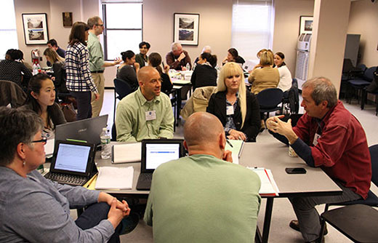
Commonality of Interest, Network helps to find people interested in the same subject or problem around the world
They are not stuck with people living locally and have opportunity to find friends around the world according their interests. It would be very difficult or even impossible with old fashioned technology like telegraph, telephone or the mail post. Connectivity between people increased in thousands times.

Slide 9
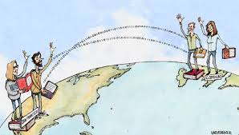
3.Real-Time Information Sharing.
The internet and computer networking give fascinating opportunity to exchange messages, the internet links, sending big files like photos or even movies.

Slide 10
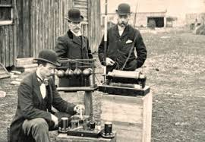
4 Social networking is a very popular tool among scientists
They find the computer networking an ideal way for collaboration , for exchanging ideas, results of scientific experiments, sharing data, and avoid duplication of research. Regardless their locations scientists work very effectively as one unit.

Slide 11
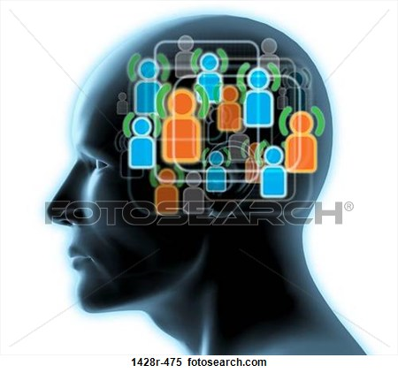
5.Using as a collective intelligence.
When a task or a problem is too difficult for one individual it can be very easy for a group of people when they use network uniting their knowledge and experience even though they are situated around the world. The collective intelligence is very popular in scientific and academic communities.

Slide 12
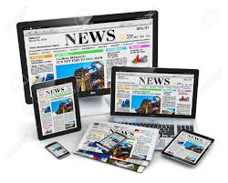
6. Taking a role of the media and liberating the freedom of speech.
On computing networking platforms people can say everything and to everybody what they want to say.
Some people already use computers instead of TVs.

Slide 13
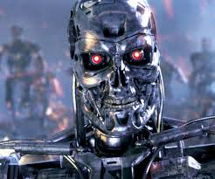
Disadvantages
As the computer social networking is a very new phenomena in our society, it is still not a perfect place for communication , and has a lot weaknesses, and even sometimes dangerous and threatening.

Slide 14
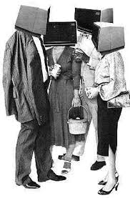
It reduces or eliminates face-to-face communication.
People, especially young people, don’t have opportunity to develop social skills.
Look at the picture, these people literally lost their faces.

Slide 15
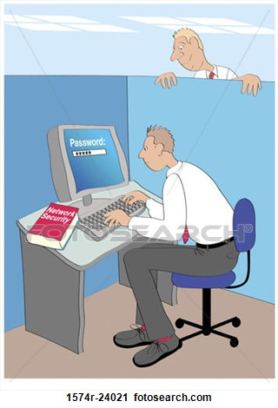
2 Risks of Fraud or Identity Theft.
For example, it may include stealing bank details, some valuable personal information like names, DOB, insurance, Insurance Number. Some people are still so naïve that give their personal information to strangers on the network.

Slide 16
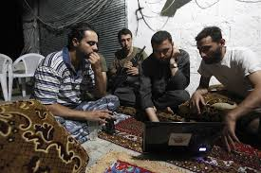
Destabilize the social live and governments and cause a lot of trouble.
Recent so called orange revolutions in Egypt, Libya, Ukraine can be examples of using computer social network for political or criminal purposes.

Slide 17
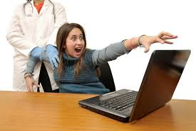
Time Wasting, obsession to computer social networking and the internet, causing distraction from home and work duties.
Some people spend in the front of a computer hours and hours neglecting their jobs, friends and home duties.
This is an example when a young woman became a victim of the internet addiction disorder, from Facebook and Twitter.

Slide 18
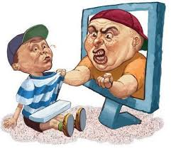
5 Cyber bullying.
It is a rude, abusive and assaulting behaviour of some users on the computer social networking sites.

Slide 19
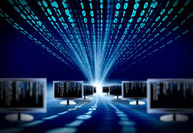
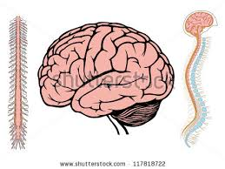
6 Too much information
The puny human brain is not designed to deal with Gigabytes and Terabytes of information.
The human brain is at risk to be sick.

Slide 20
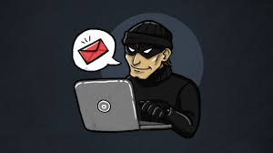
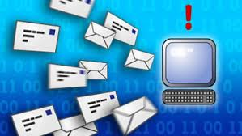
7 There are a lot of faked profiles and spammers.
Actually the computer network is not yet a proper and reliable place for communication.
When you communicate with somebody, you actually don’t know for sure whether he is a real person or a computer bot.

Slide 21
Advice and recommendations
Personally I believe that it is quite easy to overcome all these difficulties.
Mandatory courses how to use the internet and the social networking have to be introduced for all citizens. It should be like numeracy and literacy. People who attend these courses will never make stupid mistakes.
Follow the common sense. For example, people should never give vulnerable personal information or send money to anybody until you meet this person in the real live. The same rules applies like behaviour with strangers on the street.

Slide 22
My worries
I am not concerned about these disadvantages of computer networking because people learn new skills quickly and software becomes more advanced every day and sooner or later we overcome these difficulties.
I worry about human society and human relationships in the future.

Slide 23

“THE MACHINE STOPS”
Just recently I read book “ The Machine stops” written by Edward Foster in 1909, who actually predicted the internet and Artificial Intelligence.

Slide 24
The plot of the story is really fascinating.
The story describes a world in which most of the human population has lost the ability to live on the surface of the Earth. Each individual now lives in isolation below the service in a standard 'cell', with all bodily and spiritual needs met by the omnipotent, global Machine.
People became totally depended from the machine. And the Machine became like the object of worship. They did not communicate with each other directly, but only through the internet. Then the machine suddenly broke down and the civilization appeared on the brick of extinction.

Slide 25
Keep things on the balance
I am very surprised how Edward Foster predicted the internet, a computer and Artificial Intelligence more than one hundred years ago, long before the first computer was build.
I am sure that the computer and networking are our greatest achievement, and will enable us the super human power. However, let us value our connection with natural world and our human relationship with each other.

